Slide 1
Ski-Bums
Gareth Jones, Alison Wall, Megan Wall & Syd Reynolds

Slide 2
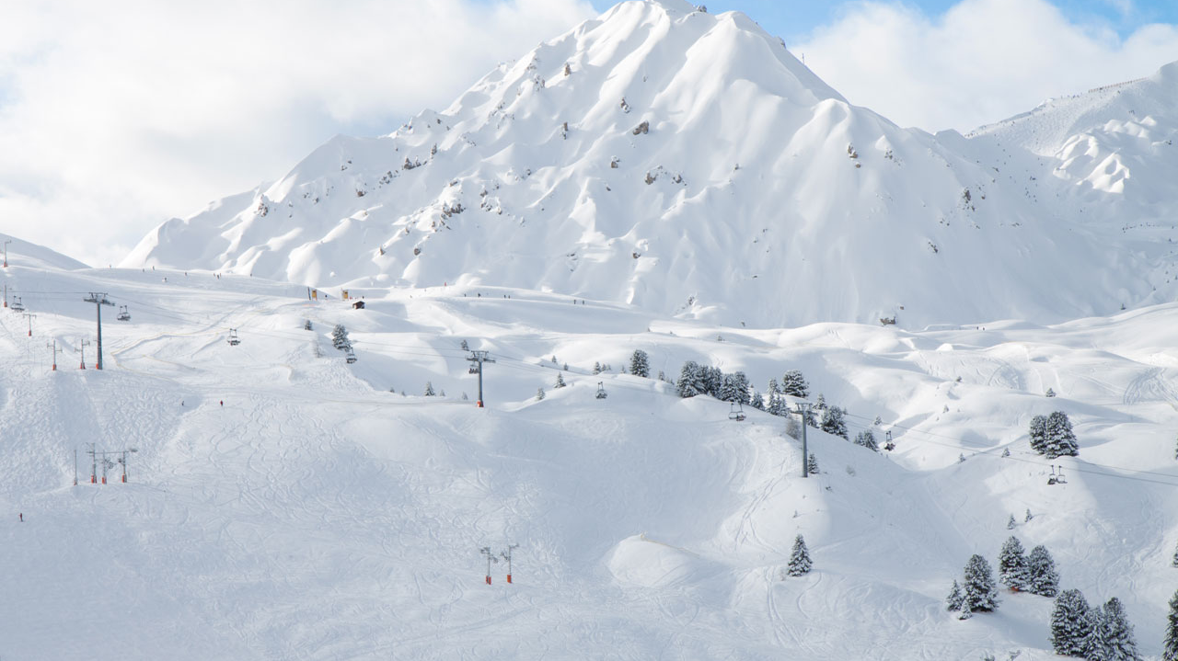
Outline
The goal of this project is to web applications that allows users to search a database of ski resorts and view a list of suggested destinations based on their criteria. The complexity of the project is dynamic based due to the complexity of the preference algorithm and the output generated for the user.
Example Input:
Maximum Driving Time
Minimum expected snowfall
Minimum number of Runs
Example Output:
Driving Time/Directions
Trail Map
Expected or Current Snowfall

Slide 3



Schematic
Web App
(Django/Flask)
SQL Database
Google Maps
API
Ski Descriptions API
Weather/Snowfall API
Preference Algorithm

Slide 4

Data/API
Weather API (Number of Sources)
Weather Reports
Expected Snowfall
Google Maps API
Distance Matrix
Directions
Resort Descriptions (Number of Sources)
Wikipedia
Sno-Country
Includes Weather Data

Slide 5
Components
Gareth Jones | Syd Reynolds | Megan Wall | Alison Wall
Managing Database SQL Database Scrubbing or Enhancing as necessary | Django or Flask Building the website Determine how website with interact with database | APIs Ski-Descriptions Sno-Country Wikipedia Google Maps Distance Matrix Route/Directions | Preference Algorithm Search database for search terms Rank output in a meaningful way

Slide 6
Timeline
January 31st
Acquire Data
Determine whether enhancement or additional sources are needed
February 9th
Build Database
Decide on Structure/Format
Determine how to mesh with interface
February 23rd
Create Web Interface
Write algorithm to rank destinations based on user preference
Decide on outputs
Access Relevant Databases
March 13th
Submit Project

